Slide 1


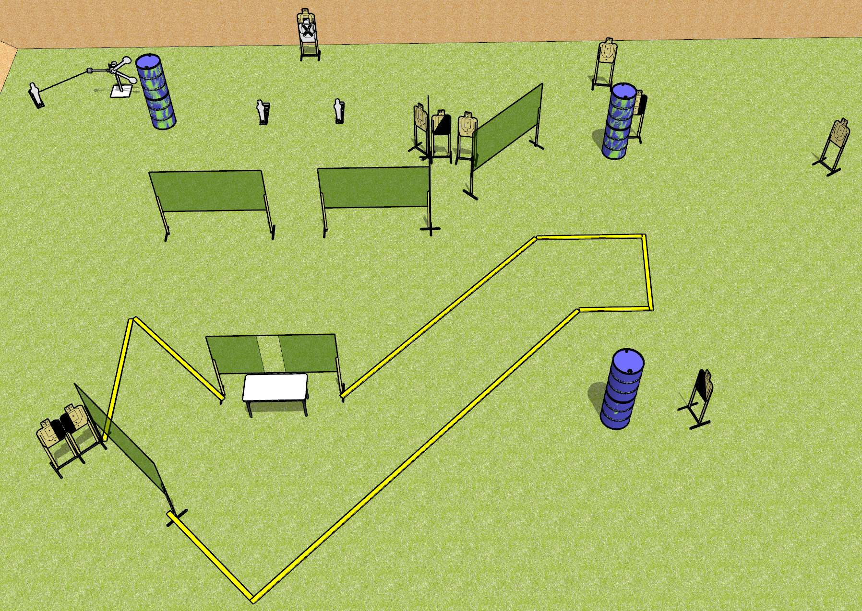
 | Dothan Gun Club – USPSA Match For Your Eyes Only Course Designer : Drew Coleman
Round Count 25 rounds 10 USPSA 3 poppers, 2 plates
Equipment List 11 wall feet 1 left + 1 right, 1 left + 1 right diag, 1 tux, 6 targets (5 + 1 NS) Red stitch swinger + activator 3 18x24 plates and stands

Slide 2
For Your Eyes Only
Written Stage Briefing
For Your Eyes Only is a 25 round, 125-point, Comstock course of fire. There are 10 USPSA targets and 5 steel. The best 2 hits on cardboard will score and steel must fall to score.
The swinger is activated by a popper and remains visible at rest.
Briefcase will be closed and unlatched. Paster will be centered on lid of briefcase. Briefcase must be touching marks on table and may open left OR right.
Handgun start position is hands on marks. Pistol is inside briefcase, unloaded, pointed down range. First magazine to be used on top of brief case, touching paster.
PCC start position is hands on marks. Magazine is inside briefcase. Carbine is on top of briefcase, touching paster, unloaded, pointed down range.
On the audible start signal, engage targets as they become available from within the shooting area.

